Slide 1
Faculty: INFORMATION TECHNOLOGY Department: Information Management| Networks and Communications Systems| Software Engineering INSY 8212:Programming with C

Slide 2
Module contents
Introduction to computers
Types of programming languages
Introduction to C
Features of C
Compilers
Running C programs.
Define Character set, identifiers and keywords, variables, declaring variables, data types, displaying variables, reading variables, constants

Slide 3
Single character input - single character output- scanf function, writing output data - the printf function
Arithmetic operators, relational operators, logical operators, bitwise operators, comma operator, conditional operator.

Slide 4
If statement, if-else statement, switch statement. Loops, for loop, while loop, do while loop, break statement, continue statement, goto statement
Operations on array
Array illustrations
Multi-dimensional arrays
Strings
Defining a function, recursion.
Defining a structure
Uses of pointers

Slide 5
Introduction to computers
A computer is an electronic device that processes data and performs tasks according to a set of instructions called a program. It can store, retrieve, and process information, making it a powerful tool for various applications.

Slide 6
Here are some basic components and functions of a computer:
Central Processing Unit (CPU): Often called the "brain" of the computer, the CPU performs calculations and executes instructions.
Memory (RAM): Random Access Memory (RAM) temporarily stores data that the CPU needs while performing tasks. It is fast but volatile, meaning it loses its data when the computer is turned off.

Slide 7
Storage: Computers use various forms of storage to retain data long-term. Hard drives (HDDs) and solid-state drives (SSDs) are common types of storage devices.
Input Devices: These include keyboards, mice, and other devices that allow users to input data into the computer.

Slide 8
Output Devices: Monitors, printers, and speakers are examples of devices that output data from the computer in a usable form.
Operating System (OS): This is the software that manages the hardware and software resources of the computer, providing a user interface and managing applications.

Slide 9
Computers come in various forms, including personal computers (PCs), laptops, tablets, and servers. They are essential in many fields, from business and education to entertainment and scientific research.

Slide 10
Servers
Servers are specialized computers designed to manage, store, and process data for multiple users or systems over a network. Unlike personal computers, which are typically used by one person at a time, servers provide services and resources to many users simultaneously. They play a crucial role in networks, data centers, and cloud computing environments.

Slide 11
Types of programming languages
Programming languages come in many types, each designed for different kinds of tasks. Here's a broad overview of some key categories:
Low-Level Languages:
Machine Language: The most basic form of programming language, consisting of binary code that a computer's CPU directly executes.
Example: binary code ; 6= 110, 1 ( 2² ) + 1 ( 2¹ ) + 0 ( 2⁰ )

Slide 12
Cont…
Assembly Language: A human-readable representation of machine code, using pre-defined word called mnemonics for operations and addresses. It’s specific to a computer’s architecture.
Example: Add A, B

Slide 13
2. High-Level Languages:
Object-Oriented Languages: Focus on objects and classes to organize code.
C++: An extension of C that includes object-oriented features.
Java: Known for its portability across platforms, thanks to the Java Virtual Machine (JVM).
Python: Emphasizes readability and ease of use, with support for multiple programming paradigms.

Slide 14
What is C?
C is a high-level, procedural programming language developed in the early 1970s by Dennis Ritchie at Bell Labs. It has influenced many other programming languages and remains widely used today for systems programming, embedded systems, and application development due to its efficiency and control over system resources.

Slide 15
Key Features of C:
Simplicity: C provides a relatively small set of keywords and constructs, which helps in understanding and mastering the language.
Efficiency: C allows for direct manipulation of hardware and memory, providing high performance and control.

Slide 16
Cont…
Portability: Programs written in C can be compiled and run on different types of computer systems with minimal modification.
Rich Set of Operators: C supports a wide variety of operators for mathematical, logical, and bitwise operations.

Slide 17
Cont…
Structured Programming: C promotes structured programming by supporting functions, allowing code to be organized into modules for better readability and maintenance.
Standard Library: C provides a standard library of functions for performing common tasks, such as input/output operations, string manipulation, and mathematical computations.

Slide 18
Compilers
In the world of computer programming, the C Compiler plays a crucial role in transforming human-readable code into an executable form for computers to understand.

Slide 19
Source code
The source code is typically written in a high-level, human-readable language such as Java or C++.
A programmer writes the source code in a code editor or an integrated development environment (IDE) that includes an editor, saving the source code to one or more text files.
A compiler that supports the source programming language reads the files, analyzes the code, and translates it into a format suitable for the target platform.

Slide 20
Running C programs.
C language Tutorial with programming approach for beginners and professionals, helps you to understand the C language tutorial easily.
The C Language is developed by Dennis Ritchie for creating system applications that directly interact with the hardware devices such as drivers, kernels, etc. C programming is considered as the base for other programming languages, that is why it is known as mother language.

Slide 21
Basic Syntax and Concepts:
Hello, World! Program:
#include <stdio.h>
int main() {
printf("Hello, World!\n"); return 0;
}
#include <stdio.h>: Includes the Standard Input Output library needed for printf.
int main(): The main function where execution starts.
printf(): A function used to output text to the console.
return 0;: Indicates successful completion of the program

Slide 22
Character set in C
A character set is a collection of all characters (like letters, digits, symbols, etc.) that can be used in code. It is classified into two main categories: the source character set and the execution character set in C.

Slide 23
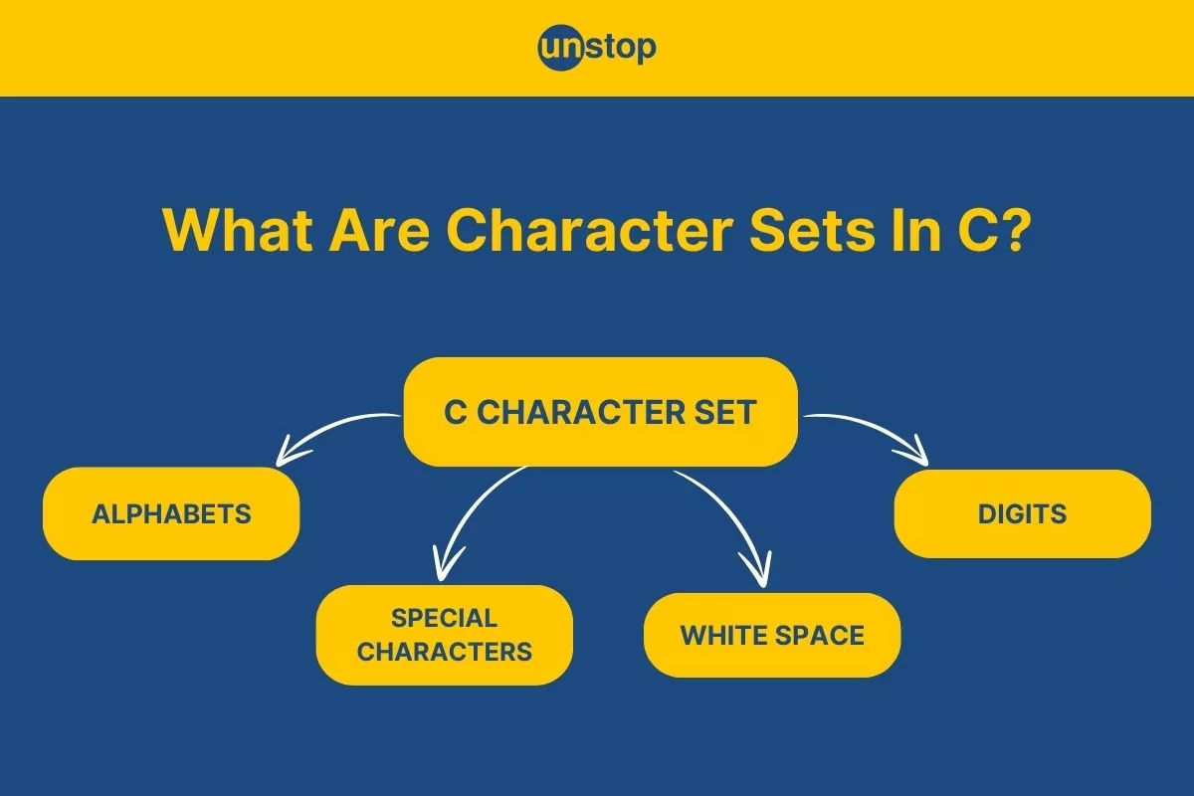

Slide 24
The source character set
In the C programming language, the character set refers to a set of all the valid characters that we can use in the source program for forming words, expressions, and numbers. The source character set contains all the characters that we want to use for the source program text.

Slide 25
Execution Character Set (ECS):
The execution character set is the encoding/programming used for the text of your program that is input to the compilation phase after all preprocessing steps. This character set is used for the internal representation of any string or character literals in the compiled code.

Slide 26
Identifiers and Keywords
In C programming, identifiers and keywords play crucial roles in the structure and syntax of the code. Here's a detailed look at each:
Identifiers
Identifiers are names given to various program elements such as variables, functions, arrays, etc. They allow you to refer to these elements in your code. Here are the key rules and characteristics of identifiers in C:

Slide 27
1. Rules for Identifiers:
Start with a Letter or Underscore: Identifiers must begin with a letter (uppercase or lowercase) or an underscore (_). They cannot start with a digit.
Followed by Letters, Digits, or Underscores: After the first character, identifiers can include letters, digits, and underscores.

Slide 28
Cont…
Case Sensitivity: Identifiers are case-sensitive. For example, Variable, variable, and VARIABLE would be considered different identifiers.
No Reserved Keywords: Identifiers cannot be the same as C keywords

Slide 29
2. Examples of Valid Identifiers:
Count
total_sum
MAX_VALUE
myVariable1

Slide 30
Examples of Invalid Identifiers:
1variable (starts with a digit)
total sum (contains a space)
int (reserved keyword)

Slide 31
Keywords
Keywords are reserved words that have special meaning in C and cannot be used as identifiers.
They are part of the language's syntax and serve specific purposes.
Each keyword is used to define the structure and behavior of the code.

Slide 32
1. List of C Keywords:
Data Types: int, char, float, double, void
Control Flow: if, else, switch, case, default, break, continue, return
Storage Classes: auto, register, static, extern
Modifiers: signed, unsigned, long, short
Logical Operators: &&, ||, !
Others: sizeof, typedef, struct, union, enum, goto, const, volatile, restrict

Slide 33
2. Examples of Keywords in Use:
#include <stdio.h>
int main() { int count = 10;
// 'int' is a keyword for integer data type if (count > 5) { //
'if' is a keyword for conditional statements printf("Count is greater than 5.\n");
} return 0;
// 'return' is a keyword used to exit the function }

Slide 34
Summary
Identifiers: Used to name variables, functions, arrays, etc. Must follow specific naming rules and cannot be the same as keywords.
Keywords: Reserved by the language for specific syntactical functions. They cannot be used as identifiers and have predefined meanings in the C language.
Understanding and correctly using identifiers and keywords is fundamental to writing effective and error-free C programs.

Slide 35
Variables
In programming, we often need a named storage location to store the data or values. Using variables, we can store the data in our program and access it afterward.
Variables are containers for storing data values, like numbers and characters.

Slide 36
Cont…
In C, there are different types of variables (defined with different keywords), for example:
int - stores integers (whole numbers), without decimals, such as 123 or -123
float - stores floating point numbers, with decimals, such as 19.99 or -19.99
char - stores single characters, such as 'a' or 'B'. Characters are surrounded by single quotes

Slide 37
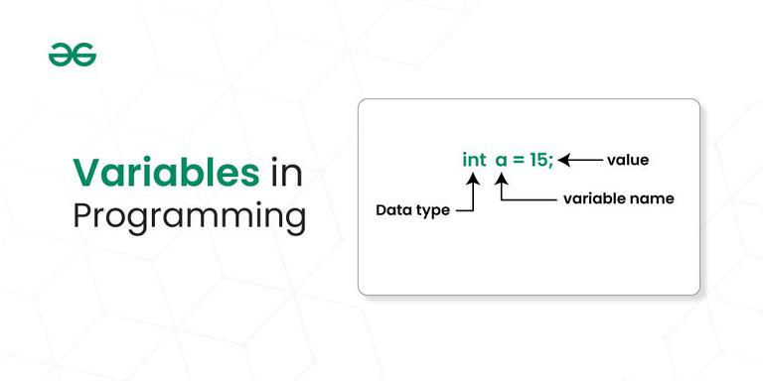

Slide 38
Declaration of Variable in Programming
In programming, the declaration of variables involves specifying the type and name of a variable before it is used in the program. The syntax can vary slightly between programming languages, but the fundamental concept remains consistent.
To create a variable, specify the type and assign it a value:

Slide 39
Syntax
type variableName = value;
Where type is one of C types (such as int), and variableName is the name of the variable (such as x or myName). The equal sign is used to assign a value to the variable.
Example
Create a variable called myNum of type int and assign the value 15 to it:
int myNum = 15;

Slide 40
Cont…
You can also declare a variable without assigning the value, and assign the value later:
Example
// Declare a variable
int myNum;
// Assign a value to the variable
myNum = 15;

Slide 41
Example
#include <stdio.h>
int main()
{
// Syntax: datatype variable_name;
int age;
double price;
char grade;
return 0;
}

Slide 42
Initialization of Variable in Programming:
Initialization of variables In Programming involves assigning an initial value to a declared variable. The syntax for variable initialization varies across programming languages.

Slide 43
Example
#include <stdio.h>
int main()
{
// Declaration and Initialization
int age = 25;
double price = 10.99;
char grade = 'A';
return 0;
}

Slide 44
Data types
Each variable in C has an associated data type. It specifies the type of data that the variable can store like integer, character, floating, double, etc.
Each data type requires different amounts of memory and has some specific operations which can be performed over it.
The data type is a collection of data with values having fixed values, meaning as well as its characteristics.

Slide 45
Cont…
The data type specifies the size and type of information the variable will store.
In this tutorial, we will focus on the most basic ones:
Data Type | Size | Description | Example
int | 2 or 4 bytes | Stores whole numbers, without decimals | 1
float | 4 bytes | Stores fractional numbers, containing one or more decimals. Sufficient for storing 6-7 decimal digits | 1.99
double | 8 bytes | Stores fractional numbers, containing one or more decimals. Sufficient for storing 15 decimal digits | 1.99
char | 1 byte | Stores a single character/letter/number, or ASCII values | 'A'

Slide 46
Basic Format Specifiers
There are different format specifiers for each data type. Here are some of them:
Format Specifier | Data Type
%d or %i | int
%f or %F | float
%lf | double
%c %s | Char string

Slide 47
Cont…
Note: It is important that you use the correct format specifier for the specified data type, or the program may produce errors or even crash.

Slide 48
Displaying variables
The C library printf() function is a fundamental tool for outputting formatted text to the standard output stream. It allows for versatile printing of variables, strings, and other data types.

Slide 49
Cont…
The syntax of the C Printf function is as follows: printf("format string", argument1, argument2, ...);
The format string contains the text along with the format specifiers that should be replaced with the values provided in the argument list.
Example:int age = 25; printf("Your age is: %d", age);

Slide 50
Reading variables
The scanf() function is a commonly used input function in the C programming language. It allows you to read input from the user or from a file and store that input in variables of different data types.
Input is an essential part of most programs, and the scanf() function provides an easy way to read input in a variety of formats.

Slide 51
Scanf()format
The most common conversion specifiers are:
%d: reads an integer value
%f: reads a floating-point value
%c: reads a single character
%s: reads a string of characters
%lf: reads a double-precision floating-point value

Slide 52
Example:
For example, the following code reads an integer value and a floating-point value from the user, and stores them in the variables num and fnum, respectively:

Slide 53
Cont…
#include <stdio.h>
int main() {
int num;
float fnum;
printf("Enter an integer and a floating-point number: ");
scanf("%d %f", &num, &fnum);
printf("You entered %d and %f\n", num, fnum);
return 0;
}

Slide 54
Cont…
In this example, the format string "%d %f" tells scanf() to read an integer value followed by a floating-point value, separated by a space.
The & operator is used to pass the address of the num and fnum variables to scanf(), so that the input values can be stored in those variables.

Slide 55
Arithmetic operators
Arithmetic Operators are the type of operators in C that are used to perform mathematical operations in a C program. They can be used in programs to define expressions and mathematical formulas.

Slide 56
Types of Arithmetic Operators in C
The C Arithmetic Operators are of two types based on the number of operands they work. These are as follows:
Binary Arithmetic Operators
Unary Arithmetic Operators

Slide 57
Binary Arithmetic Operators in C
The C binary arithmetic operators operate or work on two operands. C provides 5 Binary Arithmetic Operators for performing arithmetic functions which are as follows:

Slide 58
Operator | Name of the Operator | Arithmetic Operation | Syntax
+ | Addition | Add two operands. | x + y
– | Subtraction | Subtract the second operand from the first operand. | x – y
* | Multiplication | Multiply two operands. | x * y
/ | Division | Divide the first operand by the second operand. | x / y
% | Modulus | Calculate the remainder when the first operand is divided by the second operand. | x % y

Slide 59
Example of Binary Arithmetic Operator in C
// C program to demonstrate syntax of binary arithmetic
// operators
#include <stdio.h>
int main()
{
int a = 10, b = 4, res;
// printing a and b
printf("a is %d and b is %d\n", a, b);
res = a + b; // addition
printf("a + b is %d\n", res);
res = a - b; // subtraction
printf("a - b is %d\n", res);
res = a * b; // multiplication
printf("a * b is %d\n", res);
res = a / b; // division
printf("a / b is %d\n", res);
res = a % b; // modulus
printf("a %% b is %d\n", res);
return 0;
}

Slide 60
Output
a is 10 and b is 4
a + b is 14
a - b is 6
a * b is 40
a / b is 2
a % b is 2

Slide 61
Unary Arithmetic Operators in C
The unary arithmetic operators operate or work with a single operand. In C, we have two unary arithmetic operators which are as follows:

Slide 62
Operator | Symbol | Operation | Implementation
Decrement Operator | — | Decreases the integer value of the variable by one. | –h or h–
Increment Operator | ++ | Increases the integer value of the variable by one. | ++h or h++
Unary Plus Operator | + | Returns the value of its operand. | +h
Unary Minus Operator | – | Returns the negative of the value of its operand. | -h

Slide 63
Relational Operators in C
In C, relational operators are the symbols that are used for comparison between two values to understand the type of relationship a pair of numbers shares.
The result that we get after the relational operation is a boolean value, that tells whether the comparison is true or false.
Relational operators are mainly used in conditional statements and loops to check the conditions in C programming.

Slide 64
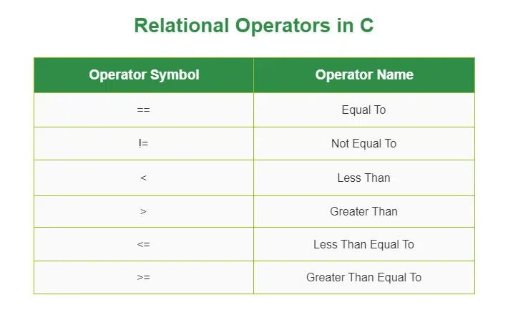

Slide 65
Equal to operator (==)
The C equal to operator (==) is a relational operator that is used to check whether the two given operands are equal or not.
Equal to operator is a binary operator hence it requires two operands to perform the comparison.
If the two values are equal, it returns true. Otherwise, it returns false.

Slide 66
Syntax
operand1 == operand2
For example, 5==5 will return true.

Slide 67
Not equal to operator (!=)
The C not equal (==) to operator is another relational operator used for checking whether the two given operands are equal or not.
It is also a binary operator, requiring two operands to perform the comparison.
It is the exact boolean complement of the ‘==’ operator which returns true if the two values are not equal, false otherwise.

Slide 68
Syntax
operand1 != operand2
For example, 5!=5 will return false.

Slide 69
Logical operators
Logical operators in C are used to combine multiple conditions/constraints. Logical Operators returns either 0 or 1, it depends on whether the expression result is true or false. In C programming for decision-making, we use logical operators.
We have 3 logical operators in the C language:
Logical AND ( && )
Logical OR ( || )
Logical NOT ( ! )

Slide 70
Types of Logical Operators
Logical AND Operator ( && )
The logical AND operator (&&) returns true only if both operands are non-zero. Otherwise, it returns false (0). The return type of the result is int. Below is the truth table for the logical AND operator.

Slide 71
X | Y | X && Y
1 | 1 | 1
1 | 0 | 0
0 | 1 | 0
0 | 0 | 0
Syntax
(operand_1 && operand_2)

Slide 72
Example
// C program for Logical
// AND Operator
#include <stdio.h>
// Driver code
int main()
{
int a = 10, b = 20;
if (a > 0 && b > 0) {
printf("Both values are greater than 0\n");
}
else {
printf("Both values are less than 0\n");
}
return 0;
}

Slide 73
Logical OR Operator ( || )
The logical OR operator returns true if any one of the operands is non-zero. Otherwise, it returns false i.e., 0 as the value. Below is the truth table for the logical OR operator.

Slide 74
X | Y | X || Y
1 | 1 | 1
1 | 0 | 1
0 | 1 | 1
0 | 0 | 0
Syntax
(operand_1 || operand_2)

Slide 75
Example
// C program for Logical
// OR Operator
#include <stdio.h>
// Driver code
int main()
{
int a = -1, b = 20;
if (a > 0 || b > 0) {
printf("Any one of the given value is "
"greater than 0\n");
}
else {
printf("Both values are less than 0\n");
}
return 0;
}

Slide 76
Logical NOT Operator ( ! )
If the given operand is true then the logical NOT operator will make it false and vice-versa. Below is the truth table for the logical NOT operator.
X | !X
0 | 1
1 | 0
Syntax
!(operand_1 && operand_2)

Slide 77
Example
// C program for Logical
// NOT Operator
#include <stdio.h>
// Driver code
int main()
{
int a = 10, b = 20;
if (!(a > 0 && b > 0)) {
// condition returned true but
// logical NOT operator changed
// it to false
printf("Both values are greater than 0\n");
}
else {
printf("Both values are less than 0\n");
}
return 0; }

Slide 78
Bitwise operators
In C, the following 6 operators are bitwise operators (also known as bit operators as they work at the bit-level).

Slide 79
C provides six operators for bit manipulation.
Symbol | Operator
& | bitwise AND
| | bitwise inclusive OR
^ | bitwise XOR (exclusive OR)
<< | left shift
>> | right shift
~ | bitwise NOT (ones' complement) (unary)

Slide 80
Bitwise AND &
bit a | bit b | a & b (a AND b)
0 | 0 | 0
0 | 1 | 0
1 | 0 | 0
1 | 1 | 1

Slide 81
Cont…
The bitwise AND operator is a single ampersand: &. It is just a representation of AND which does its work on the bits of the operands rather than the truth value of the operands.
Bitwise binary AND performs logical conjunction (shown in the table above) of the bits in each position of a number in its binary form.

Slide 82
For instance, working with a byte (the char type):
11001000
& 10111000
-------- ------
= 10001000
The most significant bit of the first number is 1 and that of the second number is also 1 so the most significant bit of the result is 1; in the second most significant bit, the bit of second number is zero, so we have the result as 0.

Slide 83
Bitwise XOR ^
bit a | bit b | a ^ b (a XOR b)
0 | 0 | 0
0 | 1 | 1
1 | 0 | 1
1 | 1 | 0
The bitwise XOR (exclusive or) performs an exclusive disjunction, which is equivalent to adding two bits and discarding the carry. The result is zero only when we have two zeroes or two ones.[3] XOR can be used to toggle the bits between 1 and 0. Thus i = i ^ 1 when used in a loop toggles its values between 1 and 0

Slide 84
11001000
^ 10111000
-------- ------
= 01110000

